Slide 1

Introduction to E2DISP
Examples

Slide 2
Example 5.1
A bottle opened to reaeration and filled with polluted water has the following characteristics:
Find and c(t) after
(a) 1/3 × 10⁴ s; (b) 5/3 × 10⁴ s; (c) 1/3 × 10⁵ s.
Also, find the critical time t_{c}, critical DO deficit D_{c} and critical DO c_{c}.

Slide 3
Example 5.1 – Analytical Solution
(a) After 86400 s

Slide 4
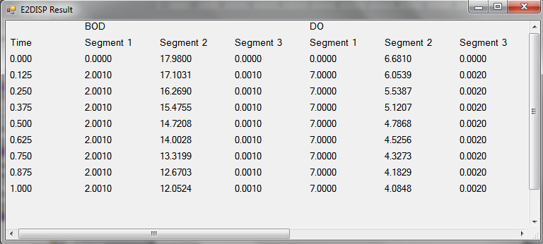
Example 5.1 – E2DISP

Slide 5
River Example
Simulate BOD-DO of a river receiving BOD waste from a factory at the rate of Q_{e} = 0.5 m³/s with = 50 mg/L and c_{e} = 5 mg/L
This river has the following characteristics:

Slide 6
River Example
Effluent:
River:

Slide 7
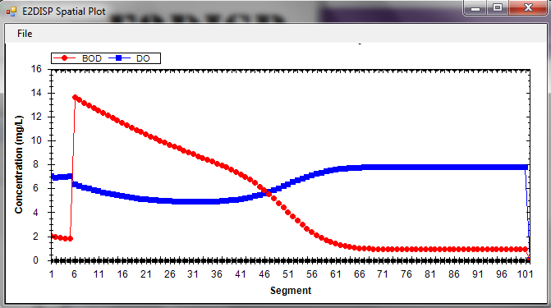
River Example – E2DISP Solution

Slide 8
Thank you
Presented by
Assoc. Prof. Dr. Teh Su Yean | School of Mathematical Sciences

